Slide 1
Early European Colonization and the Chesapeake 1600-1700
European Colonization

Slide 2
Learning Objectives
Analyze primary source documents to understand how Europeans perceived Native Americans
Explain how differences in imperial goals, cultures, and the North American environments led Europeans to develop diverse patterns of colonization

Slide 7
What was the triangular trade?

Slide 8
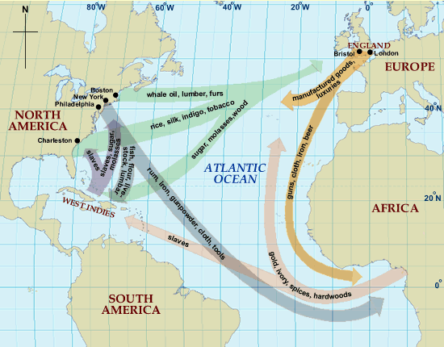

Slide 9
Zinn: What is the outcome of Spanish activity in the Caribbean? In other words, what happened to the Arawak?
Primary Sources: What general pattern of Spanish conquest does las Casas present in A Brief Account?
Primary Sources: How did las Casas structure his report to most influence the king's response?

Slide 10
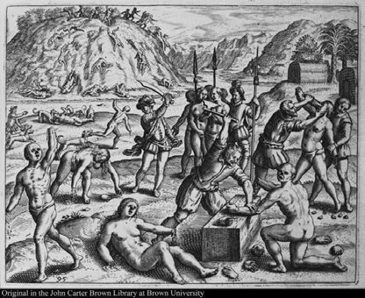
Another time, because the Indians did not give him a
coffer filled with gold, . . . they killed an infinite number of souls, and cut off the hands and noses of countless women and men, and others they threw to the savage dogs, who ate them and tore them to pieces.

Slide 11
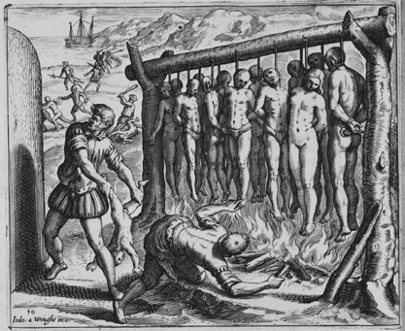
They would erect long gibbets . . . and bind thirteen of the Indians at one time, in honour and reverence, they said, of Our Redeemer and the twelve Apostles, and put firewood around it and burn the Indians alive.

Slide 12
Bartholome De La Casas
Former conquistador and friar who wrote A Short account of the Destruction of the In 1542
Published in 1543
Exposed the atrocities of the Spanish
Theodore De Bry’s Copper engravings popularized the work
Helped spread the “Black Legend” which gave protestant countries (the Dutch and English) moral justifications for their colonization efforts

Slide 13
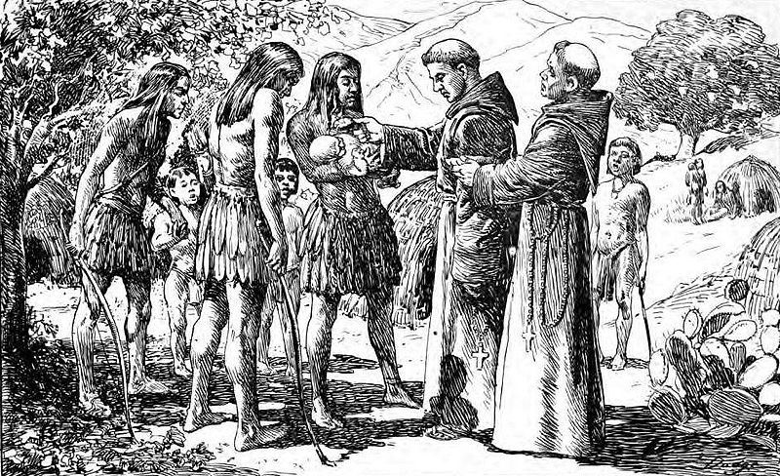
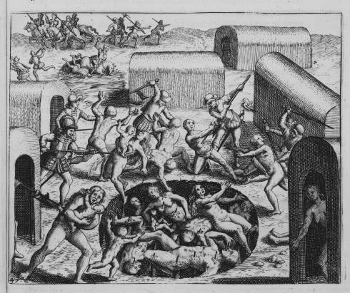
The Spanish
Spain sought to establish tight control over the process of colonization in the Western Hemisphere and to convert and/or exploit the native population

Slide 14
The Spanish (Conquest)
Practiced the encomienda (forced labor) system and later the repartimiento
Spain regarded the Native Americans as a usable (disposable?) labor force
Eventually replace Native Labor with African Slavery
Developed the Casta System

Slide 15
Pueblo Rebellion
Fray Alonso de Posada (in New Mexico 1656–1665) "forbade Kachina dances by the Pueblo Indians and ordered the missionaries to seize every mask, prayer stick, and effigy they could lay their hands on and burn them …”
Pope, and 47 others, are arrested in 1675 for “sorcery
In 1680 Pope leads a rebellion, runs out the Spanish, killing 400
The Spanish return in 1692 but accommodate Native religion

Slide 16
Conflict and Resistance
In 1598 Juan de Oñate led 600 to 700 Spanish into the Rio Grande valley of New Mexico
Oñate put down a revolt at Acoma Pueblo
about 200 Acoma survivors out of a population of nearly 2,000. Indian men of fighting age were sentenced to foot amputation- 20 years of servitude
Still Controversial today

Slide 17
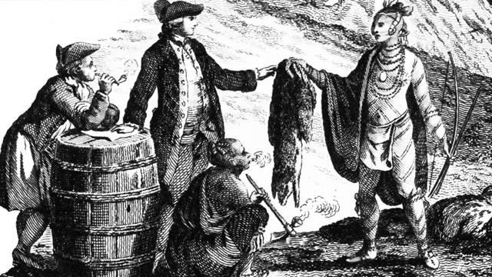
French and Dutch (Commerce)
French and Dutch colonial efforts involved relatively few Europeans
used trade alliances and intermarriage with Native Americans to acquire furs and other products for export to Europe
Correur du Bois
French population is still only 3,000, mostly men in 1663
Many took Native American wives (Metis)

Slide 18
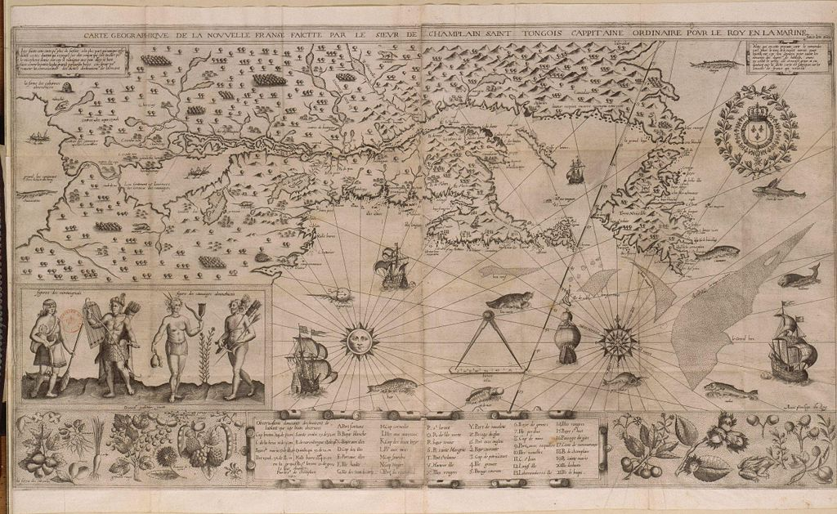
Map of New France 1612

Slide 19
Create a chart illustrating the differences and similarities between French and Dutch colonization efforts.

Slide 20
Difference French vs Dutch
French
Aimed to dominate a huge territory from the St. Lawrence Valley through the Great lakes and down to Mississippi river
Focused on establishing close relationships with the Native Americans
missionaries to convert Natives to Catholicism
Dutch
Focused on the Mid-Atlantic Region, especially the Hudson River Valley
Stayed close to the cost
Organized by the Dutch West Indies Company, interests mainly commercial
They brought their Protestant churches but did not engage in large scale missionaries

Slide 21
English (Settlement)
the English sought to establish colonies based on agriculture
sending relatively large numbers of men and women to acquire land and populate their settlements

Slide 22
Jamestown
Roanoke Colony (1587) = FAIL
Jamestown (in the Chesapeake) is founded in 1607 by Virginia Company of London, hoping to find gold
104 original settlers, 1/5 “gentlemen”
By 1608 only 35 remain
Colony turns to Tobacco
Exports 2,000 pounds in 1615, 1.5 million in 1630

Slide 23
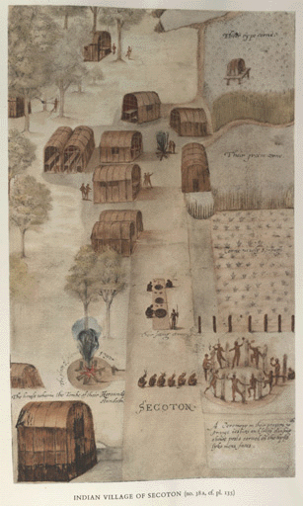
John White “Indian Village of Secoton"http://www.virtualjamestown.org/images/white_debry_html/plate35.html

Slide 24
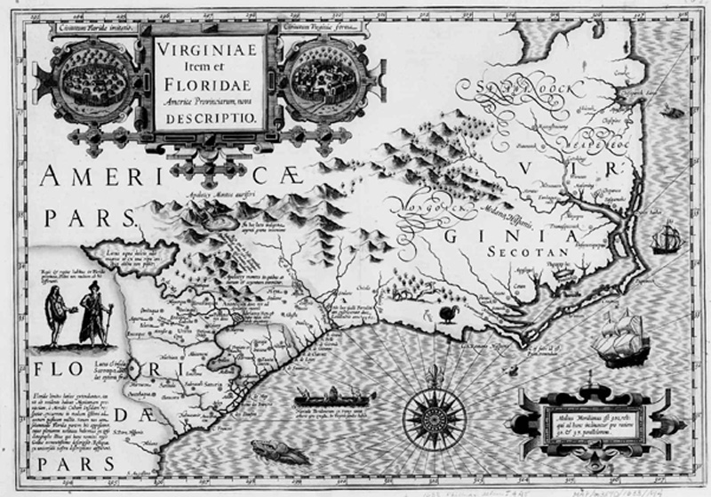
Mercator’s Map of the Carolina Coast (1633)
http://www.virtualjamestown.org/map4.html

Slide 25
John Smiths Map of Virginia (1608)
http://www.virtualjamestown.org/jsmap_large.html

Slide 26
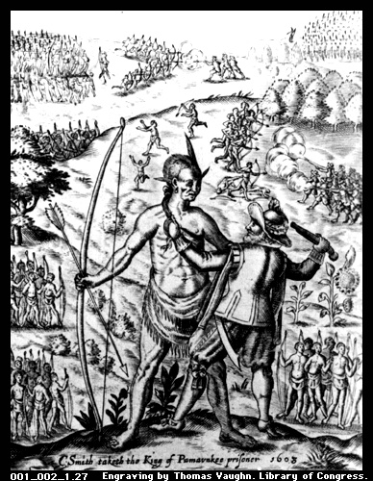
John Smith and Chief Opechancanough (1608)
http://www.vcu.edu/engweb/Rivertime/smithope.jpg

Slide 27
How did the English settlers of New England differ in terms of persons and goals from those who settled in Chesapeake?

Slide 28
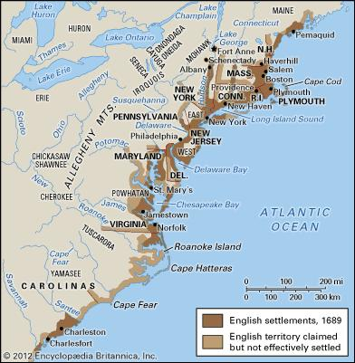

Slide 29
New England
The New England colonies,
founded primarily by Puritans
developed a close-knit, homogeneous society
aided by favorable environmental conditions developed a thriving mixed economy of agriculture and commerce

Slide 30
Chesapeake and Middle Colonies
Demographically, religiously, and ethnically diverse
Middle Colonies supported a export economy based on cereal crops,
Chesapeake colonies and North Carolina relied on the cultivation of tobacco
based on white indentured servants and African chattel

Slide 31
Southern Colonies
Took advantage of long growing seasons by using slave labor to develop economies based on staple crops
In some cases, enslaved Africans constituted the majority of the population

Slide 32
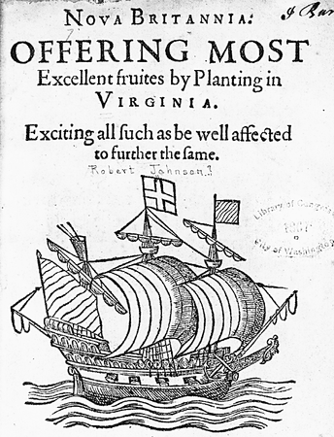
Chesapeake
The Charter of the Virginia Company:
Guaranteed to colonists the same rights as Englishmen as if they had stayed in England.
This provision was incorporated into future colonists’ documents.
Colonists felt that, even in the Americas, they had the rights of Englishmen

Slide 33
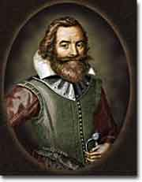
Reality
Funded by a joint stock
Colonists were literally ruled by the Virginia Company
“Work or Starve”
Whipping, branding, death penalty
The rich generally paid fines

Slide 34
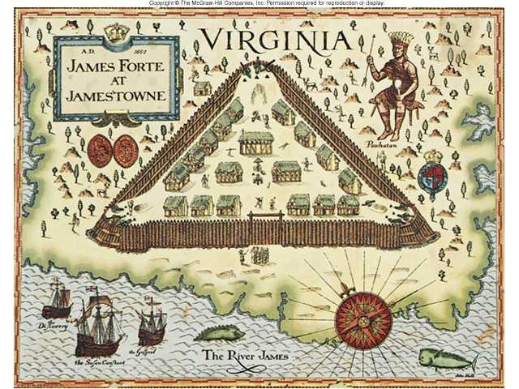
Jamestown Settlement

Slide 35
The Starving Times
John Smith Jamestown is “a miserie, a ruine, a hell”
Population drops from 104 to 38 1607-1608
300 more arrive in 1609, by 1610 60 remain
Over 7,000 migrants arrive between 1607-1625 but the population is only 1,200 in 1624

Slide 36
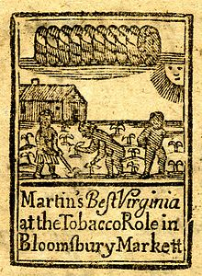
Tobacco
Economy shits to the production of Tobacco as an export
1616 1,250 pounds 1634 500,000 pounds 1669 15,000,000 pounds 1700 28,000,000 pounds

Slide 37
Indentured Servitude
Headright System:
Each Virginian got 50 acres for each person whose passage they paid.
Indenture Contract:
5-7 years.
Promised “freedom dues” [land, £]
Forbidden to marry.
1610-1614: only 1 in 10 outlived their indentured contracts!
75-85% of those who migrated to VA and MD in 17th century are indentured servants

Slide 38
Chesapeake Demographics
120,000 immigrants (1607-1700)
70~85 percent indentured servants; 15~30 percent free persons
sex ratios: servants: 6 men to 1 woman free persons: 2.4 men to 1 woman
1607-1625: death rate of 4 out of 5 or 80%
Population: 8,000 in 1640 25,000 in 1660 62,800 in 1700

Slide 39
House of Burgesses: 1619
The House of Burgesses established in 1619 & began to assume the role of the House of Commons in England
Control over finances, militia, etc.
By the end of the 17^{c}, H of B was able to initiate legislation.
A Council appointed by royal governor
Mainly leading planters.
Functions like House of Lords.
High death rates ensured rapid turnover of members.
In 1624 James I revoked the Virginia Company’s Charter and placed Virginia under direct Royal Control

Slide 40
What does Bacon’s Rebellion tell us about class relations during the period? I.e. why is there conflict and who is discontented with whom?

Slide 41
Class Clash
Wealth landowners make up 5% of the population but controlled most of the fertile Tidewater
Late 1600s large numbers of young, poor, endebted discontented men in the Chesapeake area.
Little access to land or women for marriage.
1670 the Virginia Assembly disenfranchised most landless men!

Slide 42
Bacon’s Rebellion 1676
Rebels attacked Native American, whether they were friendly or not to whites.
Governor Berkeley driven from Jamestown.
They burned the capital.
Rebels went on a rampage of plundering.
Bacon suddenly died of fever.
Berkeley brutally crushed the rebellion and hanged 20 rebels.

Slide 44
Explain what factors contributed to the use of the slave system in Chesapeake.

Slide 45
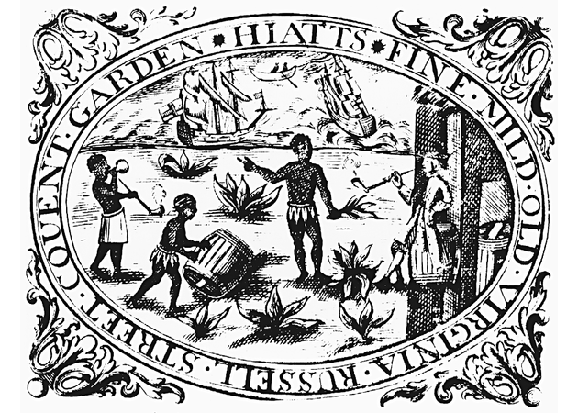
Slavery
First Africans arrived in Jamestown in 1619.
Their status was not clear → perhaps slaves, perhaps indentured servants.
Slavery not important economically until the end of the 17^{c}.

Slide 46
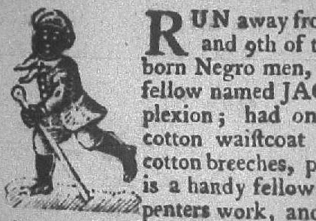
Colonial Slavery
Beginning in 1662 → “Slave Codes”
Virginia was one of the first states to acknowledge slavery in its laws, initially enacting such a law in 1661
Made blacks [and their children] property, or chattel for life of white masters.
In some colonies, it was a crime to teach a slave to read or write.

Slide 47
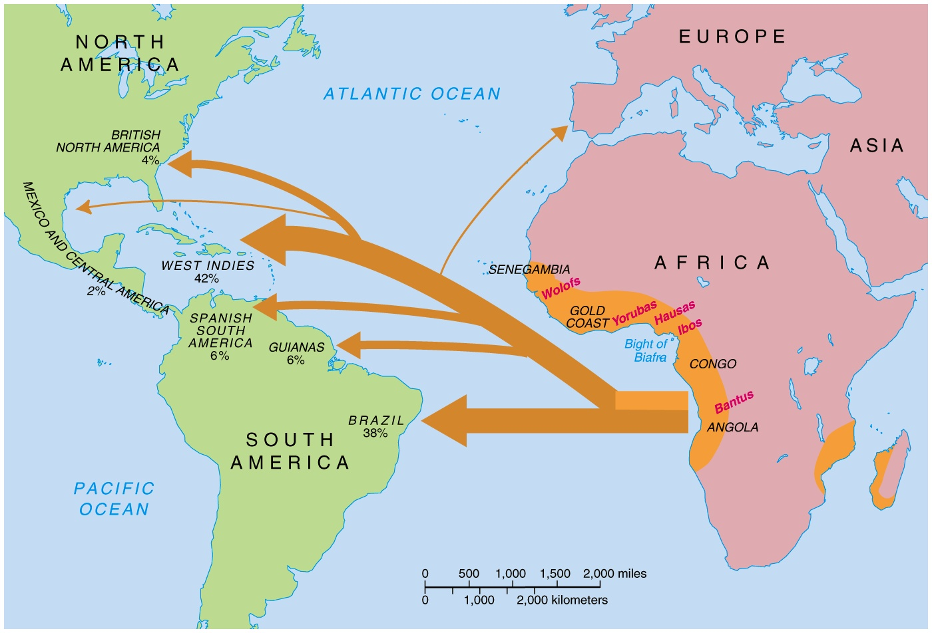
Atlantic Slave Trade

Slide 48
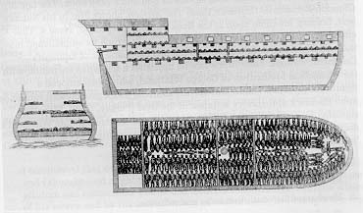

Slide 49
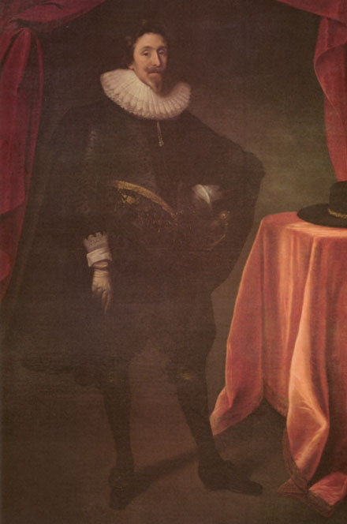
Maryland
A royal charter was granted to George Calvert, Lord Baltimore, in 1632.
A proprietary colony created in 1634.
A healthier location than Jamestown.
Tobacco would be the main crop.
His plan was to govern as an absentee proprietor in a feudal relationship.
Huge tracts of land granted to his Catholic relatives.

Slide 50
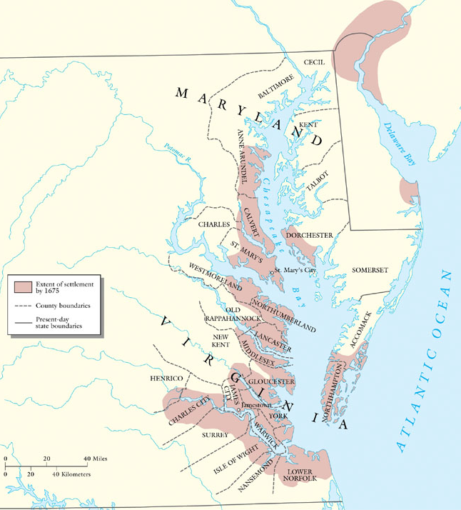

Slide 51
Maryland
Colonists only willing to come to MD if they received land.
Colonists who did come received modest farms dispersed around the Chesapeake area.
Catholic land barons surrounded by mostly Protestant small farmers.
Conflict between barons and farmers led to Baltimore losing proprietary rights at the end of the 17^{c}.
In the late 1600s, black slaves began to be imported.

Slide 52
Religious Tolerance?
Baltimore permitted high degree of freedom of worship in order to prevent repeat of persecution of Catholics by Protestants.
High number of Protestants threatened because of overwhelming rights given to Catholics.
Toleration Act of 1649
Supported by the Catholics in MD.
Guaranteed toleration to all CHRISTIANS.
Decreed death to those who denied the divinity of Jesus [like Jews, atheists, etc.].
In one way, it was less tolerant than before the law was passed!!

Slide 53
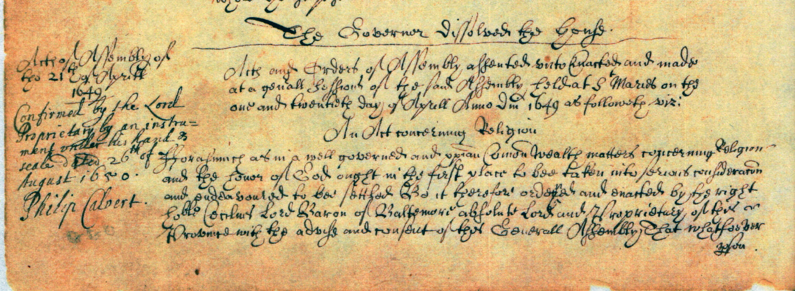
MD Toleration Act

Slide 54
Explain how English migration was rooted in population shifts, poverty, and prosperity.

Slide 55
English Migration
England is crowded, hungry and poor. Between 1520 and 1580 England’s population grows from 2.5 million to 3.5 million
London’s population quadrupled to 200,000 in the same time
Enclosures and demands for rent undermined peasants security
From 1560’s on many in government promote plantations in Scotland to “settle” the idle
About 500,000 English settlers head to North America between 1600-1700

