Slide 1
The Early Republic

Slide 2
Learning Objectives
Understand the evolving role of the Supreme court in the early 18th century
Understand the conflict between state and federal government's as the two seek to define the constitution’s federal system
Understand the early expressions of national culture
Hudson River School
First Party Systems (Crash Course)
Second Great Awakening (Thurs)
Utopian Communities (Thurs)
Seneca Falls (Thurs)

Slide 3
Today’s Agenda
Discuss Friday’s DBQ
Finish Marbury V. Madison in small groups
Lecture and discussion on
America’s experiment with mass democracy
America’s unified (and divided) national culture
Thursday Territorial Expansion, Foreign Policy and Slavery and the South

Slide 4
Timeline (1801-1829)
1801–1809 Jefferson president
1803 Marbury V. Madison
1807 Embargo Act
1819 McCulloch v. Maryland
1809–1817 Madison president
1817 –1825 Monroe President
1825 to 1829 John Quincy Adams President

Slide 5
Timeline (1801-1829)
1829–1837 Andrew Jackson President
1831 Cherokee Nation v. Georgia
1832 Worcester v. Georgia
1837–1841 Martin Van Buren President
1848 Seneca Falls convention

Slide 6
McCulloch v. Maryland (1819)
The Second Bank of the United States was chartered in 1816
Bank agreed to loan the federal government money in lieu of taxes
State banks began to fail in the depression of 1818
Maryland, which imposed a hefty tax on "any bank not chartered within the state."

Slide 7
McCulloch v. Maryland (1819)
Supreme Court ruled that Congress had implied powers under the Necessary and Proper Clause of Article I, Section 8 of the Constitution to create the Second Bank
Second, the Court ruled that Maryland lacked the power to tax the Bank because, pursuant to the Supremacy Clause of Article VI of the Constitution
Finally, the Court held that the "sovereignty” lies with the people of the United States, not with the individual states that comprise it
Shoots down compact theory

Slide 8
Cherokee Nation v. Georgia (1831)
1828 GA passed laws stripping local Cherokee of their rights.
authorized Cherokee removal from their lands
The Cherokee claimed they were a nation with treaty rights
Indian Removal Act Passed in 1830
Negotiations failed with Jackson and Congress
the Cherokee sought an injunction ("order to stop") at the Supreme Court
The Court ruled that it lacked jurisdiction to hear the case and could not resolve it.

Slide 9
Worcester v. Georgia (1832)
Samuel Worcester, a native of Vermont, was a minister
often advised the Cherokee about their political and legal rights under the Constitution and federal-Cherokee treaties.
GA passed a law requiring its citizens to obtain a state license before dwelling inside the Cherokee Nation.
Court rules that the native Americans cannot be regulated by states because they are separate nations.
Ruled the law unconstitutional, chastised GA for its treatment of Natives

Slide 10
Jackson’s Response
Jackson "...the decision of the Supreme Court has fell still born, and they find that they cannot coerce Georgia to yield to its mandate,"
Worcester remains in jail until 1833
Native Americans are forcibly removed
Trail of Tears 1838 (4,000 out of 17,000 die)

Slide 11
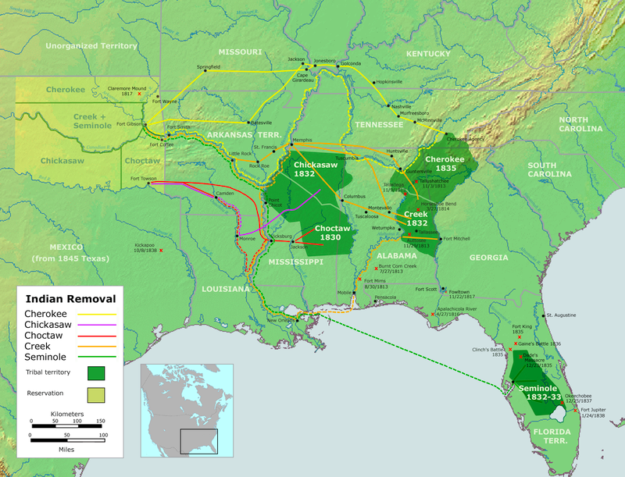

Slide 12
Nullification Crisis
Tariff Passed in 1828 (Doc A)
Take a look at the wording of the actual tariff. What type of products does this tariff affect?
What part of the country makes these goods and would benefit from this tariff?
What part of the country will find this tariff harmful to its economy and why?
Predict what the response to the tariff will be.

Slide 13
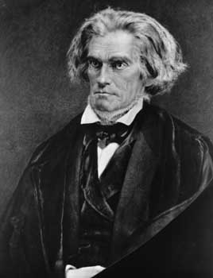
Calhoun (South)
Vice President under Andrew Jackson
Believed the Tariff of 1828 was unconstitutional since it favored the North
Insisted that states had a right to refuse to follow a law if the state felt it violated its rights
States could declare a federal law null and void
This is called nullification, a rejection of the law
He and many other Southerners called the 1928 tariff a “Tariff of Abominations”
Next three slides from: http://www.gilderlehrman.org/history-by-era/age-jackson/resources/nullification-crisis

Slide 14
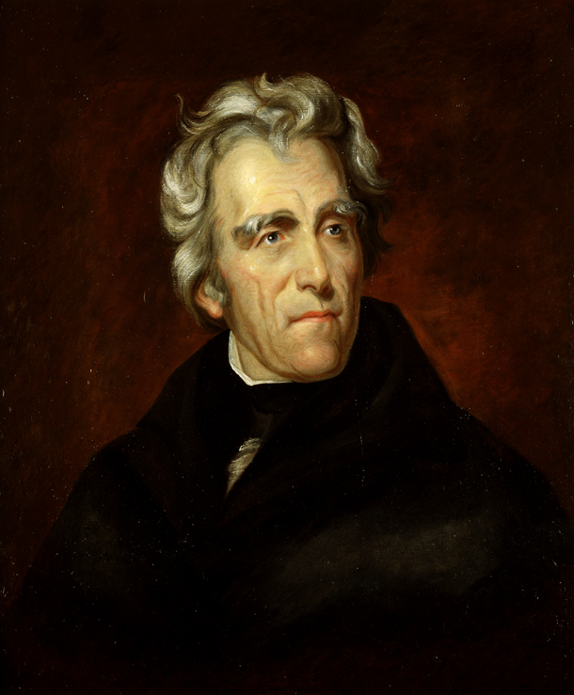
ANDREW JACKSON
7th President of the United States
Believed in preserving the Union and fought nullification
Recommended to Congress to reduce the Tariff of 1828, so they passed another tariff in 1832

Slide 15
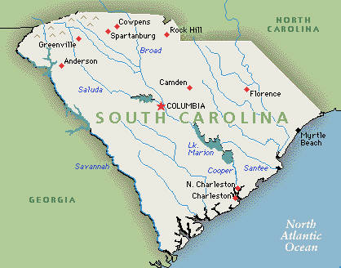
Nullification
South Carolina was not pleased with the new tariff either. They said it was oppressive, so the state passed the Nullification Ordinance in 1832.
Declared the Tariffs of 1828 and 1832 null and void
Stated they would secede if the federal government used force to make them comply.

Slide 16
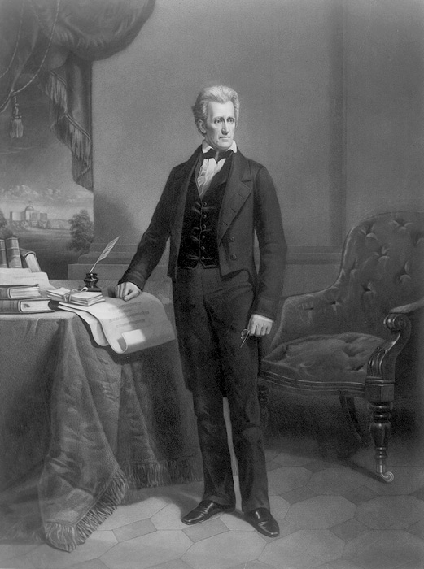
Jackson’s Response
Claimed secession would be considered treason.
Defended the federal government’s power to impose tariffs and chastised South Carolina for violating federal law because a state had no right to declare any national law null and void.

Slide 17
Force Bill
Jackson asked Congress to grant him the ability to use military force to compel South Carolina to accept and follow the law -- The Force Bill
Meanwhile Henry Clay proposed another tariff in Congress that would reduce tariffs significantly over the next ten years – Compromise Tariff
Both of these passed in 1833, and South Carolina repealed its ordinance

Slide 18
Primary Source
Group A: S. Carolina Protest (1828)
Group B: Andrew Jackson’s Nullification Proclamation (1832)
Group C: Daniel Webster’s Second Reply to Hayne (1830)
What are the main points of the article?
How does your author view the tariffs/nullification crisis?

Slide 19
Nullification Discussion
Were the tariffs fair?
Was the nullification of tariffs an appropriate response by those who disagreed with tariffs?
What can people do if they disagree with a law?
Was the Force Bill an appropriate response from President Jackson?
What do you think would have happened if South Carolina had not repealed the nullification ordinance?
How does this compare with Jackson’s Response to 1832 Worcester v. Georgia?
Who Won?

Slide 20
Who won?
Both sides claimed victory
Nationalists said they won because they showed that no state is more powerful than the federal government.
South Carolina said that the nullification process allowed them to get what they wanted.
What do you think?

Slide 21
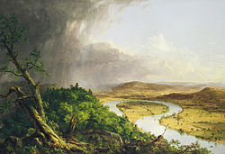
Hudson River School
19th century movement influenced by romanticism
Focused on wilderness, American Landscape
Thomas Cole
Thomas Cole (1801–1848), The Oxbow,

Slide 22
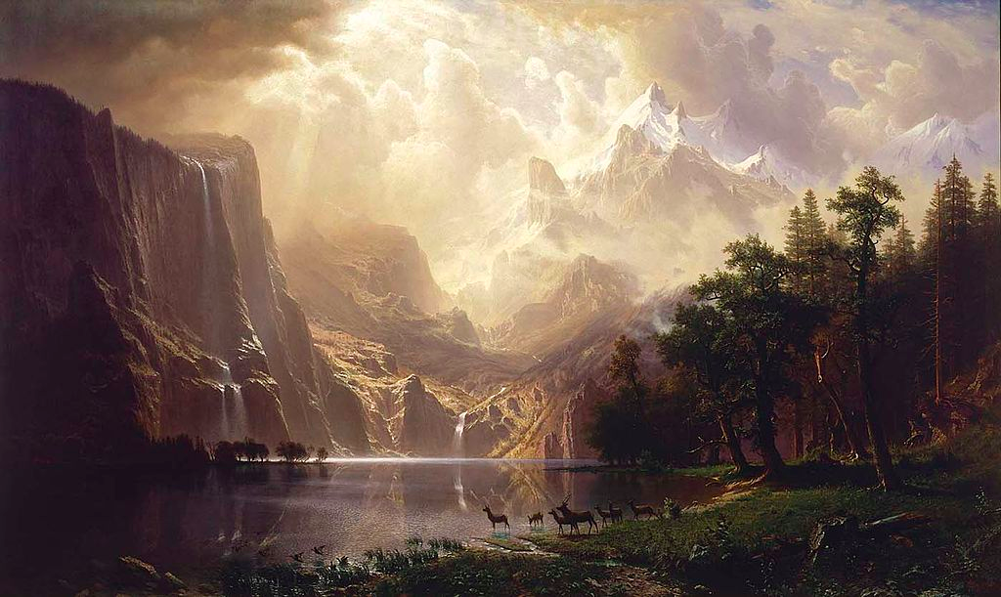
Among the Sierra Nevada Mountains, California (1868), by Albert Bierstadt

Slide 23
Emergence of Party System
What was Hamilton’s (Federalist) conception of America?
How did Jefferson (Democratic Republican disagree?

Slide 24
Seneca Falls

Slide 25
Utopian Communities

Slide 26
Second Great Awakening

Slide 27
Frederick Douglass

Slide 28
Embargo Act

