Slide 1
Andrew Jackson Debate

Slide 2
Today’s Agenda
Chairman Kuluris will introduce the hearing’s on HR 507: Removing Andrew Jackson from Removed from the $20 bill to be replaced with a Woman
Speech supporting the Bill (R)
Speech Opposing the Bill (D)
Questions to the expert panel
5 questions per Party
Closing Speeches

Slide 3
The Debate will focus on Jackson’s
Military Legacy
Mass Democracy and the common Man
Indian Removal
Nullification Crisis
The Clash over the 2nd national Bank
Due Tuesday 11/24 2 pages of notes extensively covering the above

Slide 4
Jackson’s Military Career

Slide 5
Voting Qualifications
Between 1820 and 1840
most states repealed property qualifications for voting and the secret ballot introduced
By 1840, only three states--Louisiana, Rhode Island, and Virginia--still restricted the suffrage to white male property owners and taxpayers.
voter participation skyrocketed. By 1840 nearly 80 percent of adult white males went to the polls compared to less than 20% previously

Slide 6
Jackson and Mass Democracy

Slide 7
Mass Elections
Rise of Mass Elections 44:00-1:02
Jackson organizes the first mass based election
Jackson campaign in 1828 was the first to appeal directly for voter support through a professional political organization.

Slide 8
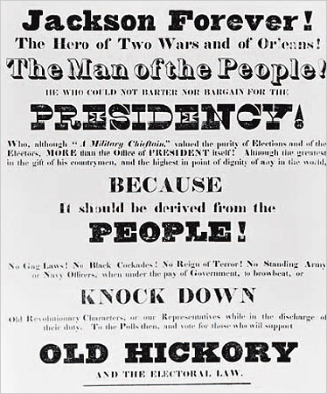

Slide 9
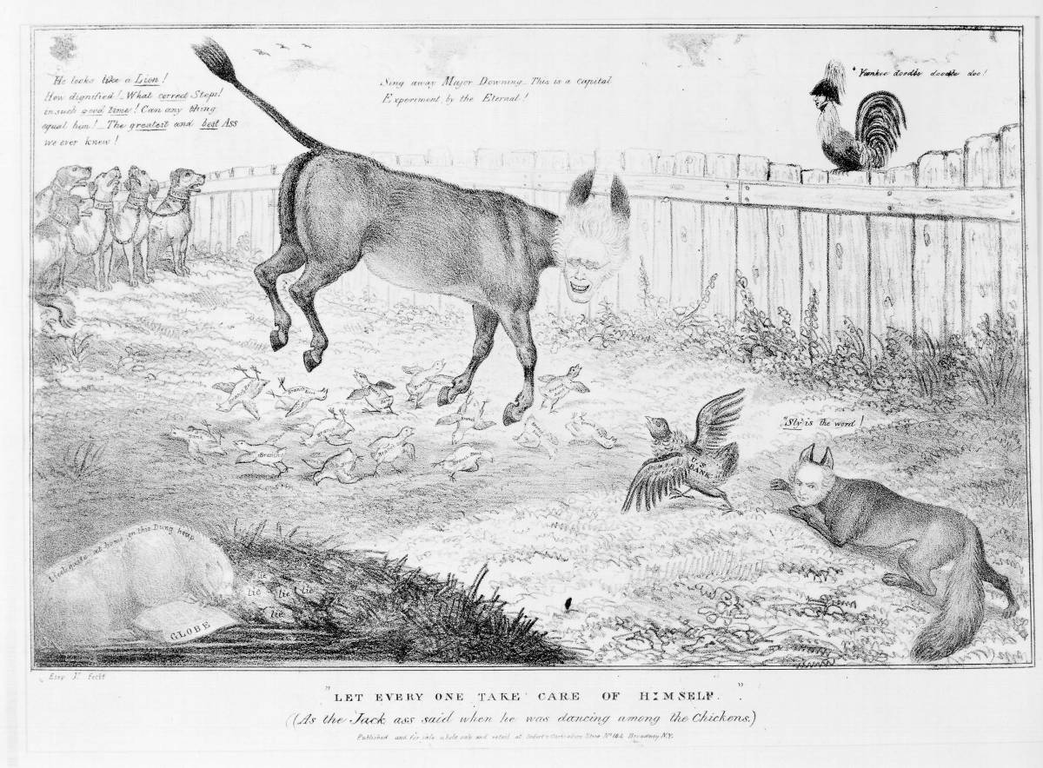

Slide 12
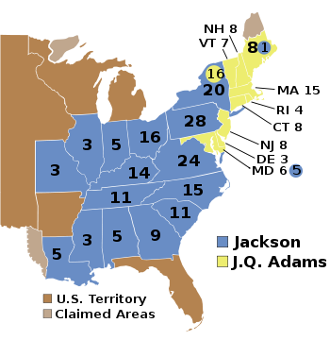
Election of 1828

Slide 13
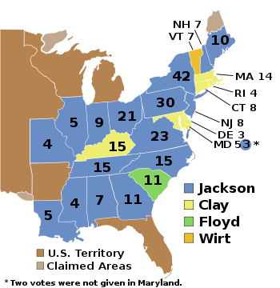
Election of 1832

Slide 14
Whigs = American System
Support for a high tariff to protect American industries and generate revenue for the federal government
Maintenance of high public land prices to generate federal revenue
Preservation of the Bank of the United States to stabilize the currency and rein in risky state and local banks
Development of a system of internal improvements (such as roads and canals) which would knit the nation together and be financed by the tariff and land sales revenues.

Slide 15
Indian Removal Bill 1830
“Philanthropy could not wish to see this continent restored to the condition in which it was found by our forebears. What good man would prefer a country covered with forests and ranged by a few thousand savages to our extensive Republic, studded with cities, towns, and prosperous farms?”
-- Andrew Jackson

Slide 16
Cherokee Nation v. Georgia (1831)
1828 GA passed laws stripping local Cherokee of their rights.
authorized Cherokee removal from their lands
The Cherokee claimed they were a nation with treaty rights
Indian Removal Act Passed in 1830
Negotiations failed with Jackson and Congress
the Cherokee sought an injunction ("order to stop") at the Supreme Court
The Court ruled that it lacked jurisdiction to hear the case and could not resolve it.

Slide 17
Worcester v. Georgia (1832)
Samuel Worcester, a native of Vermont, was a minister
often advised the Cherokee about their political and legal rights under the Constitution and federal-Cherokee treaties.
GA passed a law requiring its citizens to obtain a state license before dwelling inside the Cherokee Nation.
Court rules that the native Americans cannot be regulated by states because they are separate nations.
Ruled the law unconstitutional, chastised GA for its treatment of Natives

Slide 18
Jackson’s Response
Jackson "...the decision of the Supreme Court has fell still born, and they find that they cannot coerce Georgia to yield to its mandate,"
Worcester remains in jail until 1833
Native Americans are forcibly removed
Trail of Tears 1838 (4,000 out of 17,000 die)

Slide 19
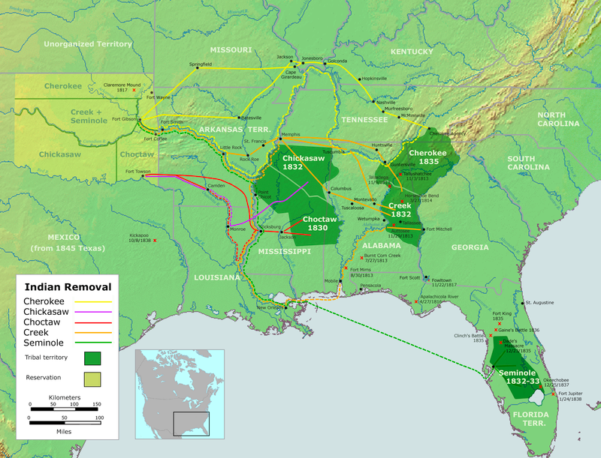

Slide 20
Nullification Crisis
Tariff Passed in 1828
“the Tariff of Abominations”—
sought to protect northern and western agricultural products from competition with foreign imports;
the resulting tax on foreign goods would raise the cost of living in the South
New Tarrif passed in 1832

Slide 21
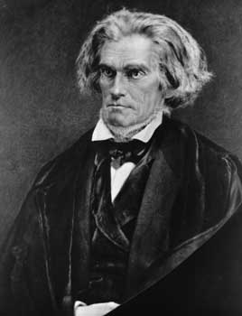
Calhoun (South)
Vice President under Andrew Jackson
Believed the Tariff of 1828 was unconstitutional since it favored the North
Insisted that states had a right to refuse to follow a law if the state felt it violated its rights
States could declare a federal law null and void
This is called nullification, a rejection of the law
He and many other Southerners called the 1828 tariff a “Tariff of Abominations”
Next three slides from: http://www.gilderlehrman.org/history-by-era/age-jackson/resources/nullification-crisis

Slide 22
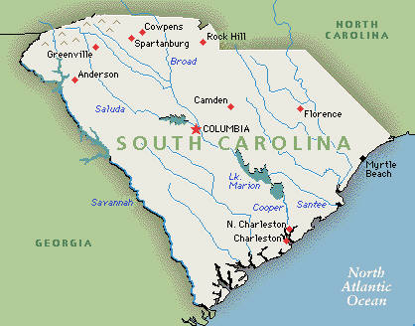
Nullification
South Carolina was not pleased with the new tariff either. They said it was oppressive, so the state passed the Nullification Ordinance in 1832.
Declared the Tariffs of 1828 and 1832 null and void
Stated they would secede if the federal government used force to make them comply.

Slide 23
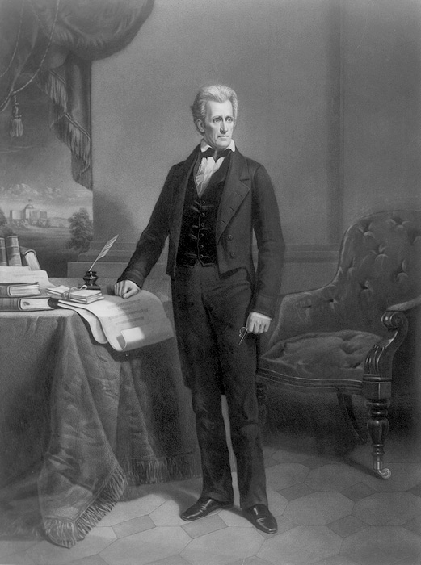
Jackson’s Response
Claimed secession would be considered treason.
Defended the federal government’s power to impose tariffs and chastised South Carolina for violating federal law because a state had no right to declare any national law null and void.

Slide 24
Force Bill
Jackson asked Congress to grant him the ability to use military force to compel South Carolina to accept and follow the law -- The Force Bill
Meanwhile Henry Clay proposed another tariff in Congress that would reduce tariffs significantly over the next ten years – Compromise Tariff
Both of these passed in 1833, and South Carolina repealed its ordinance

Slide 25
Clash over the 2nd Bank
Jackson vetoed legislation renewing the Charter in 1832
In 1833 he ordered all United States Funds to be removed

Slide 27
Clash over the bank
“Gentlemen, I have had men watching you for a long time and I am convinced that you have used the funds of the bank to speculate in the breadstuffs of the country. When you won, you divided the profits amongst you, and when you lost, you charged it to the bank. You tell me that if I take the deposits from the bank and annul its charter, I shall ruin ten thousand families. That may be true, gentlemen, but that is your sin! Should I let you go on, you will ruin fifty thousand families, and that would be my sin! You are a den of vipers and thieves.”

