Slide 1
French and Indian War

Slide 2
King Philip’s (Metacom) War 1675-1678
last major War against Native American war in New England
Background
From 1600-1675 New England's indigenous population fell from 140,000 to 10,000, while the English population grew to 50,000.
2000 natives to live in "praying towns," where they were expected to adopt white customs.
New England Indians were also forced to accept the legal authority of colonial courts.

Slide 3
King Philip’s (Metacom) War 1675-1678
1675, the chief of the Pokanokets, Metacomet (whom the English called King Philip), forged a military alliance including about two-thirds of the region's Indians. In 1675, he led an attack on Swansea, Massachusetts
Results:
Five percent of New England's population was killed
Twelve out of ninety New England towns were destroyed.
40 percent of New England's Native population was killed or fled the region

Slide 7
Inter- European and Tribal Warfare
The Beaver Wars
By 1640 Beaver populations had largely declined in North America
The Iroquois seeking more access to furs began conquering their smaller Algonquian speaking neighbors
The Iroquois are backed and armed by the English and the Dutch
The French back the Algonquian
Result Iroquois victory

Slide 9
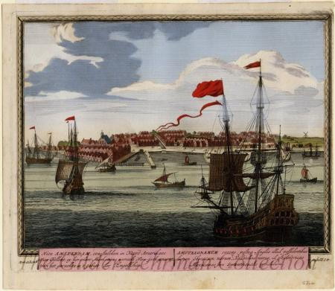
New Netherlands
In 1664 the English captured New York effectively ending the Dutch presence in North America
Dutch recapture the city in 1673 and re-lost it in 1674
Dutch Influence remains:
Freedom of Religion
Civil Liberties
Stock Market
Cookies and Coleslaw

Slide 10
Queen Anne’s War
1702-1713
N. American part of the War of Spanish Succession
Fought on 3 Fronts
Spanish Florida
Acadia (Maine)
Newfoundland
Ended by Treaty of Utrecht

Slide 11
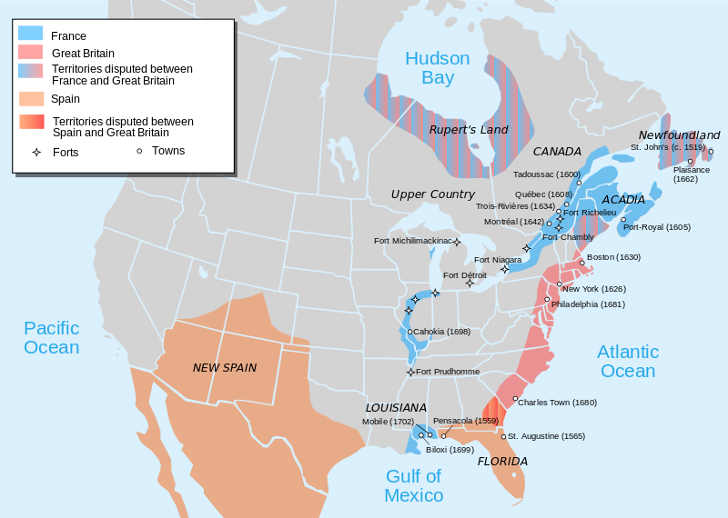
1702

Slide 12
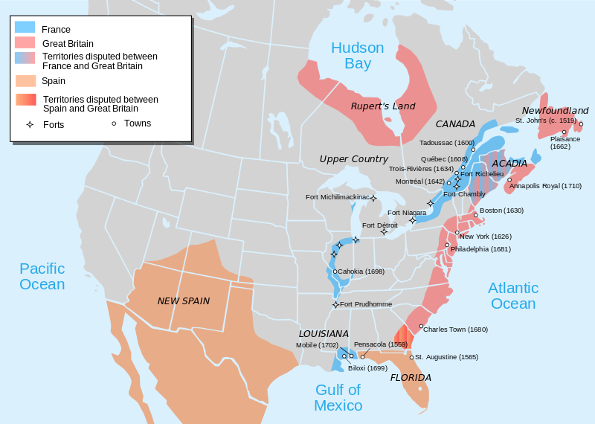
1715

Slide 13
King George’s War (1744-1748)
Name for North American part of War of Austrian Succession
Fought between French and English
Followed and coincided with War of Jenkins Ear (1739 to 1748)
Took Place in New England and New York
MA lost around 8% of its male population
Ended Status quo ante bellum after Louisburg exchanged for Madras

Slide 14
Describe the French and Indian War. What caused it?

Slide 15
Causes of the French Indian War
Ohio River valley claimed by the French and British governments
Both European countries used Native American claims to the land.
The British said it belonged to the Iroquois Indians, and the French said it belonged to the Hurons.

Slide 17
All the participants of the Seven Years' War. Blue= Great Britain, Prussia, Portugal, with allies Green= France, Spain, Austria, Russia, Sweden with allies

Slide 18
What were some of the consequences of the war?

Slide 19
Consequences
War Ends in 1763 with the Treaty of Paris
France and Spain cede all territory in N. America up to the Mississippi

Slide 20
Proclamation Line of 1763
Intended to end conflict between Native Americans and British Colonists
Many Native groups sided with the British in exchange for a promise to be left alone west of the Appalachians
Prohibited settlers west of the Appalachian Mountains
Permanent army stationed to enforce

Slide 21
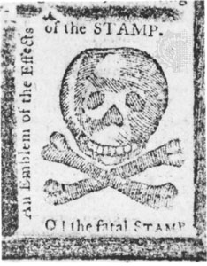
Taxes
Doubled British Crown debt. To recoup some money the Parliament passed
Sugar Act of 1764
Stamp Act of 1765
Townshend Duties of 1767 (external tax versus internal tax)

Slide 22
“No Taxation without Representation”
The British crown had no authority to tax without Parliament’s consent
American Colonists had no representation in the British Parliament

Slide 24
Video Review
The Seven-Years War (French-Indian War) and the great Awakening brought to you by John Green.

Slide 25
Thesis Statement Activity
On Your Own write each of the 2 theses for the following prompt
To what extent was the pre-Columbian landscape of North America a “pristine” wilderness
In pairs: compare your theses, decide which one is strongest and rewrite a PERFECT thesis

Slide 26
Document Based Question
Create a tentative thesis statement for your essay
In groups of 2-3 students analyze and annotate all of the documents and categorize into themes
Political
Ideology
Economic
Edit your thesis statement
Create an outline for your essay stating which 2 pieces of evidence (from the documents) will be used in each body paragraph to support your thesis
Find one piece of outside information for each body paragraph

