Slide 1
The Market Economy

Slide 2
Learning Objectives
Define Economics and Economic system
Define equilibrium price and equilibrium quantity
Explain why the price of a good or service and the amount bought and sold in a competitive market will be the equilibrium price and quantity.
Predict the effects of changes in supply and demand on equilibrium price and quantity.

Slide 3
Introductions
Name
What is the coolest thing about you?
What was the highlight of of your summer?
What are you most excited to learn about in economics?

Slide 4
Syllabus key points
Dkuluris.weebly.com
I will not accept late homework assignments.
If you are absent you are still responsible for coming to class with the assigned homework
If you are absent on the day that an assignment is due it is due the next day you come to school
Formal assignments will be accepted late for a penalty of 10% per day

Slide 5
Retake Policy
No retakes will be accepted for informal assignments
You have one week after receiving a grade to make up any FORMAL assignments. If you receive a failing grade on any of these assignments, you are expected to make it up. If an assignment is turned in late you will not be allowed to complete a retake.

Slide 6
Economics
In groups of three come up with a definition of economics

Slide 7
Economics
Economics is the study on how to allocate scarce resources in a society of unlimited wants

Slide 8
Economics
Economics answers three principle questions:
WHAT is produced
HOW is it produced
WHO consumes what is produced

Slide 9
WHAT is produced
If resources are limited, should a local government use resources to build a new school, repair an old highway, or construct a new recreation center?
If resources are limited, should American producers use resources to make goods for national defense or to provide services for retired people who are too old or ill to work?
If resources are limited, should a farmer grow wheat, cotton, or lettuce

Slide 10
HOW is it produced?
How should we obtain crude oil to meet our energy needs?
How much pollution should we allow firms to generate when producing goods?
How should hogs be raised before they become food?

Slide 11
WHO consumes what is produced?
Who should receive the limited supply of flu vaccinations?
Who should benefit from the construction of a new school?
Who should a shoe manufacturer market their products toward?

Slide 12
How do we decide this?

Slide 13
Economic System
Economic System = the particular set of social institutions that deals with the production, distribution and consumption of goods and services in society

Slide 14
What is the most important difference between a market economy and a centrally planned economy?

Slide 15
Types of Economic Systems
Traditional
Command
Market
Mixed

Slide 16
Traditional
An economic system where tradition and custom govern economic decisions
-Economic activities are usually centered toward the family, tribe, or ethnic group
-Resources are allocated based on tradition
Resource allocation varies widely by tribe
--Choices are influenced by environment

Slide 17
Command
The government or other central authority makes all economic decisions
Individuals have little, if any, influence over economic functions
Resources are owned by the government
There is no competition; the purpose of business is to provide goods and services, not to make a profit
Factories are concerned with quotas
Consumers have few, if any, choices in the market place
The government sets the prices of goods and services

Slide 18
Market (does this even exist?)
Economic decisions are made by individuals competing to earn profits based on supply and demand
Resources are owned by individuals Profit, not quotas, is the motive for increasing work
Competition determines price and increases the quality of products
Individual freedom is considered very important; individuals have freedom to make economic decisions
-Also called “capitalist” economy

Slide 19
Key Market Traits
Markets are defined by 6 key traits
Private Property
Markets and Prices
Incentives/Self Interest
Freedom of choice (this is debatable but is part of the “classic definition”)
Competition
Limited government role

Slide 20
Mixed
Combines elements of pure market and
command economies;
Government and
individuals share the economic decision making process
Government guides and regulates production of goods and services
Resources are owned by individuals
Government serves to protect both producers and consumers from unfair policies and practices

Slide 21
Maximizing utility
How is “maximizing utility” at the core of how market economies work?

Slide 22
Utility- economic term referring to the total satisfaction received from consuming a good or service.

Slide 23
How is life and economics about “trade-offs”?

Slide 24
Opportunity Cost
Opportunity Cost: The cost of an alternative that must be forgone in order to pursue a certain action. Put another way, the benefits you could have received by taking an alternative action

Slide 25
Explain
The market economy is a powerful force for making lives better. (20)
At the same time, the market is amoral. (20-21)
Our system uses prices to allocate scarce resources. (22)
Because we use price to allocate goods, most markets are self-correcting. (22-23)
If we fix prices in a market system, private firms will find some other way to compete.
Every market transaction makes all parties better off. (24-25)

Slide 26
What does the author have to say about whether a market economy is a “good” economic system?

Slide 27
Price Discrimination
What is price discrimination?

Slide 28
Price Discrimination
Price Discrimination- A pricing strategy that charges customers different prices for the same product or service. In pure price discrimination, the seller will charge each customer the maximum price that he or she is willing to pay.

Slide 29
Prices and the economy
What role do prices have in a market economy?
What is the connection between market price and supply and demand?

Slide 30
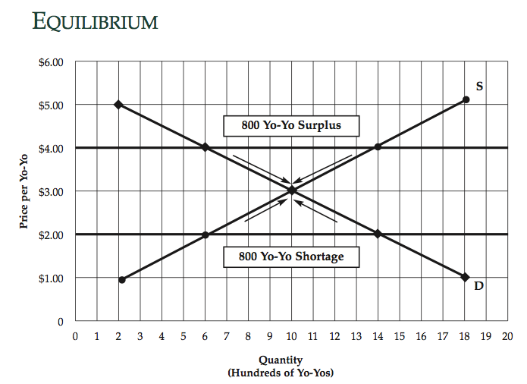

Slide 31
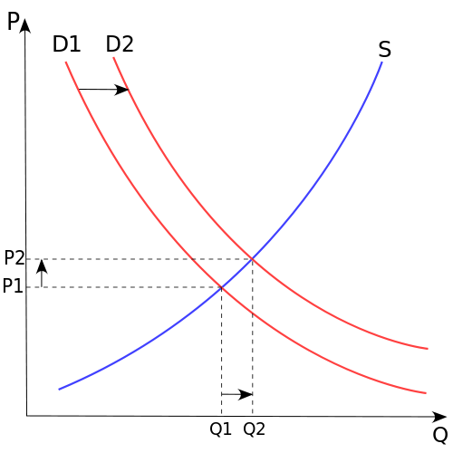
Changes in Supply and Demand

Slide 32
Changes in Demand
If demand increases (demand curve shifts to the right) and supply remains unchanged, a shortage occurs, leading to a higher equilibrium price.
If demand decreases (demand curve shifts to the left) supply remains unchanged, a surplus occurs, leading to a lower equilibrium price.

Slide 33
Changes in Supply
If demand remains unchanged and supply increases (supply curve shifts to the right), a surplus occurs, leading to a lower equilibrium price.
If demand remains unchanged and supply decreases (supply curve shifts to the left), a shortage occurs, leading to a higher equilibrium price.

Slide 34
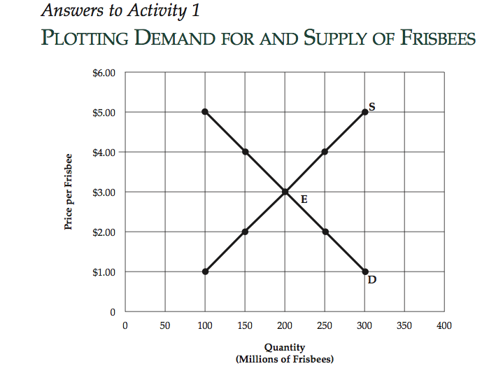

Slide 35
